Slide 1
jsinsa
sneakycode.net
@pieterkoornhof
Notes:
We as developer live in a wonderful time. Our tools are excellent, Our internet fast (mostly) and as javascript developers we have awesome new play things every other week.
We have
great practices and principles.
amazing services - mundane tasks.
team members on the other side of the globe.
All Are Great
each one creates a new point of integration
that we now have to pay attention to.
More date in different places
And with movement towards continues integration and devops, we need to find a way to consolidate all these processes and information

Slide 2
Chatops
Notes:
Enter chat ops
Chat ops is about moving tasks like projects management, deployment and monitoring into one place.
placing your tools in the middle of teams conversation
command line tool

Slide 3







Notes:
Simply put,

Slide 4
Why?
Notes:
But first lets talk about devops. Devops is about knocking down barriers between developers and operations teams, and in doing so reducing organizational frictions wherever possible.
We want to move fast. And we want to move smoothly.
It is out of this philosophy that chatops was born.

Slide 5
C
A
M
S
ulture of
utomation
easurement
haring
Notes:
Heart Of DevOps
To move fast and maintain stability it is important to have a culture of Automation, measurement and Sharing.
It is exactly this culture that chatops tries to cultivate.

Slide 6
Benefits?

Slide 7

Notes:
Chat ops gives us One centralized place to do tasks
We communicate by doing everyday things in the chat room

Slide 8
how does the load look?
is the build green?
did you push to master?
are you finished deploying?
Notes:
No longer do you have to ask.
To see what is going on you merely have to look at your chat room

Slide 9
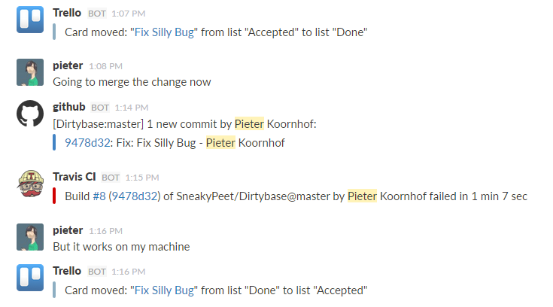
Notes:
You simply just look in the chat room

Slide 10

Notes:
The next benefit we get by default is a history of events.
You can go back at anytime and see what has happened

Slide 11
I can haz noobs?
Notes:
I makes new team members part of your team much faster
It creates a passive learning mechanism. New team members see how everything is done from day one.
It is like pair programing for team processes
We are Teaching by doing normal day to day things

Slide 12
Speed
Notes:
This also improves speed.
No more clicking around to various tools to complete a chain of tasks.
Just type a command or two in your chat room.
It also helps with remoting. You can easily trigger a deploy from your phone, from anywhere.

Slide 13
Less Email
Notes:
Because everybody loves email

Slide 14
How?

Slide 15
Culture
Notes:
To be successful at chatops, you need to build a culture of chatops

Slide 16



Notes:
Get a Chat App that does not suck and has an API and inline images.
Apps like Slack, Campfire and Hipchat are great to start with.
Slack has won.

Slide 17
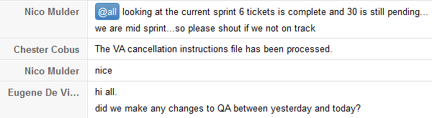
Notes:
Share A Project or Team Chat And Be Active In It.
FUN
Most things can be said in a chat message rather than in an email.
Share some interesting links.
Make chat room games.
This works better with more developers

Slide 18



Slide 19
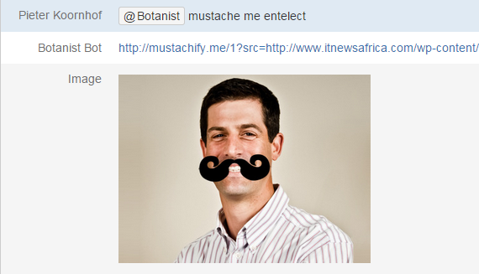

Slide 20
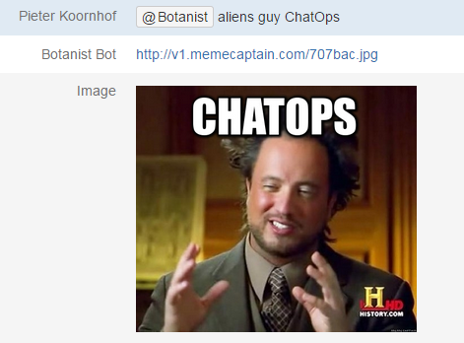

Slide 21
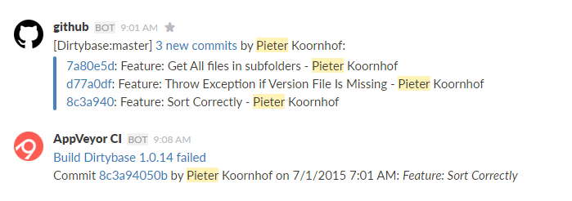
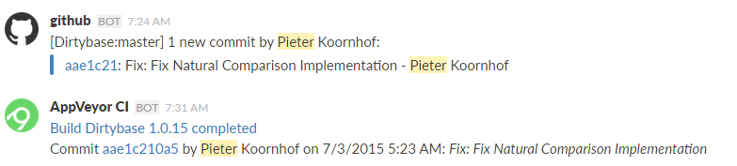
Notes:
Next web hook all the things. This is why your chat app needs an api.
User services like IFTTT and Zapier to post data from various sources.
Slack comes with a bunch of integrations right out of the box.

Slide 22

Notes:
Next, Get a chat robot
He is your chat room butler. You can ask him for many many things
We will talk about him a bit later.

Slide 23
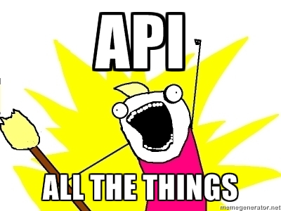
Notes:
Integration is where it is at.

Slide 24
Fun
Informative
Productive
Notes:
So to sumarize

Slide 25
What about noise?
Notes:
Putting everything into one place will be noisy!
This is something that you have to manage within your team.
Different people have different thresholds for noise.
I can see through the noise, my coleage brett hates it.
A good starting point would be to split tasks into different chat rooms. We have a team room, and projects specific chat rooms. Funny cats goes in the team room.
Don’t be afraid to change things. Ask your team what they want

Slide 26
How to chat robot?
Notes:
Lets talk about chat robots.
There are a few on the market namely hubot, lita, err, mmbot. Or you can just roll your own.
As this is a js conference we will look at hubot

Slide 27


Notes:
Hubot is a chat robot made by github
He is largely responsible for the chat ops movement.
He runs node so he is all hipster and what not.
He is written in coffee script so that makes him even more hipster. I wonder why he does not have a beard?
You can easily write scripts for hubot that you just drop in a folder (either coffee script or js)

Slide 28
https://hubot.github.com/
Notes:
Find him at

Slide 29
install
> npm install –g yo generator-hubot
> yo hubot
> npm install hubot-slack --save
Notes:
He is easy to make. You will need node.js and npm.
Install his yeoman generator
Go to a folder of choice and say yo
Optionally install a chat room adapter

Slide 30
run
> bin/hubot
> bin/hubot --adapter slack
Notes:
Run him (demo here)
Show some funnies

Slide 31
hear
robot.hear /regex goes here/, (msg) ->
msg.send ‘I hear all the things’
Notes:
Scripting is really easy
Include him
He can hear
He can respond
It is all just javascript so you can have him do anything that you can think of
Include existing scripts using npm

Slide 32
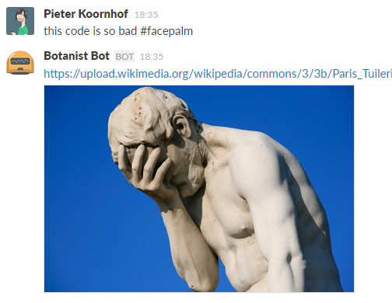

Slide 33
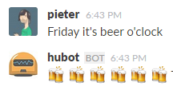

Slide 34
respond
robot.respond /regex goes here/, (msg) ->
msg.send ‘I do all the things’
Notes:
Scripting is really easy
Include him
He can hear
He can respond
It is all just javascript so you can have him do anything that you can think of
Include existing scripts using npm

Slide 35


Slide 36
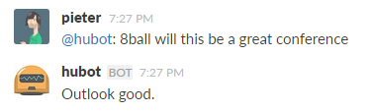

Slide 37
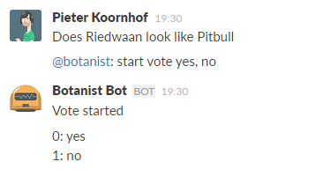

Slide 38
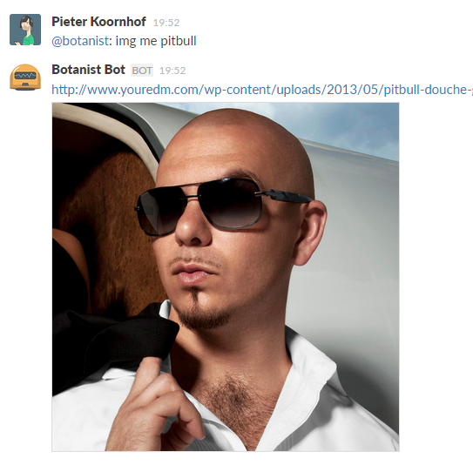

Slide 39
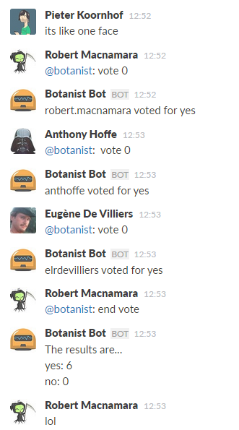

Slide 40
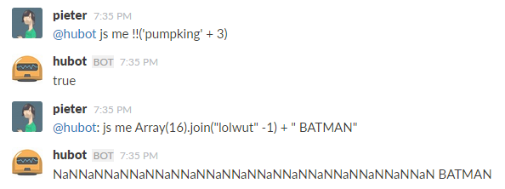

Slide 41
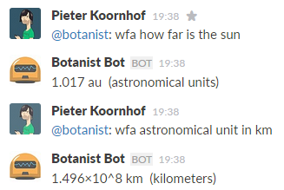

Slide 42
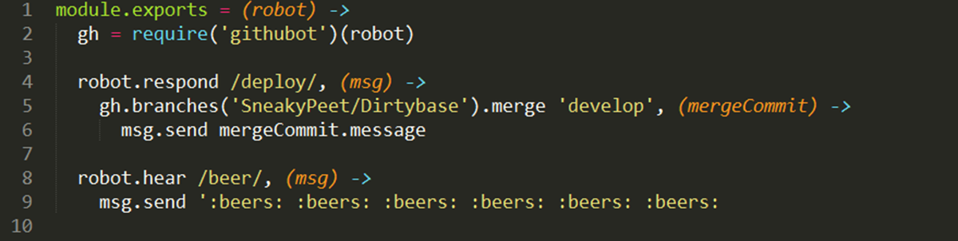

Slide 43
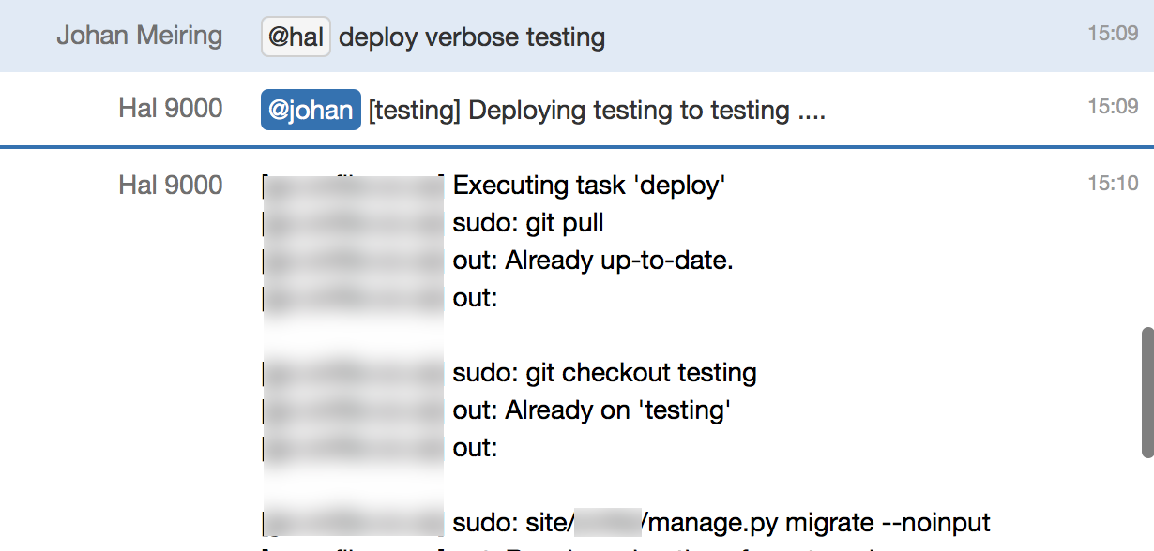
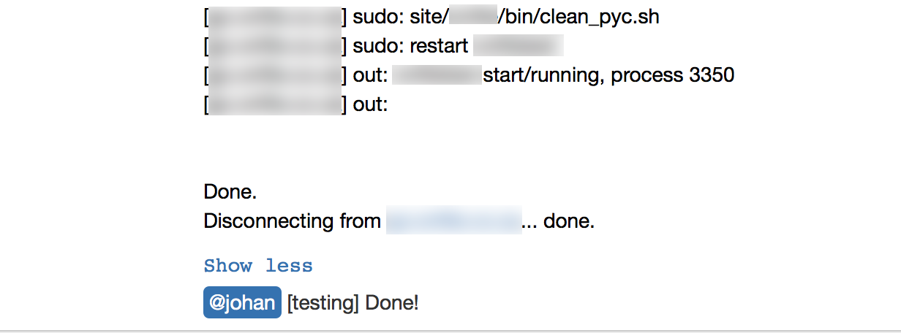
Notes:
Hubot calls a fabric script that through that deploys changes to a server through ssh.

Slide 44
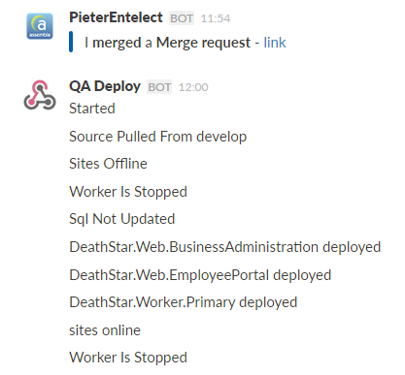
Notes:
More info

Slide 45
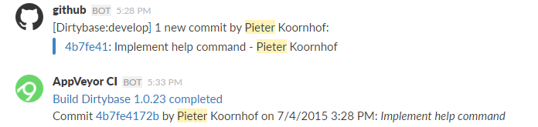
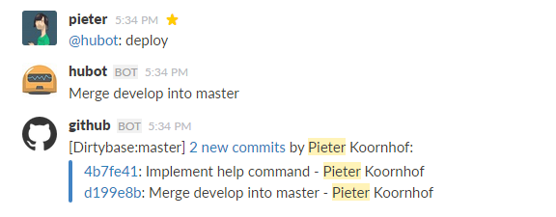

Slide 46
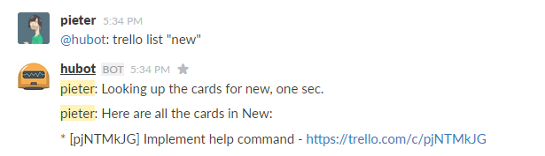
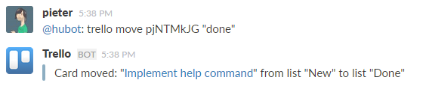

Slide 47
sneakycode.net/getting-started-with-chat-ops/
pluralsight.com
r/chatops
chatops for dummies
?
sneakycode.net
@pieterkoornhof

